Slide 1
Virtual Art Gallery
Soha Khadizatul Kubra

Slide 2
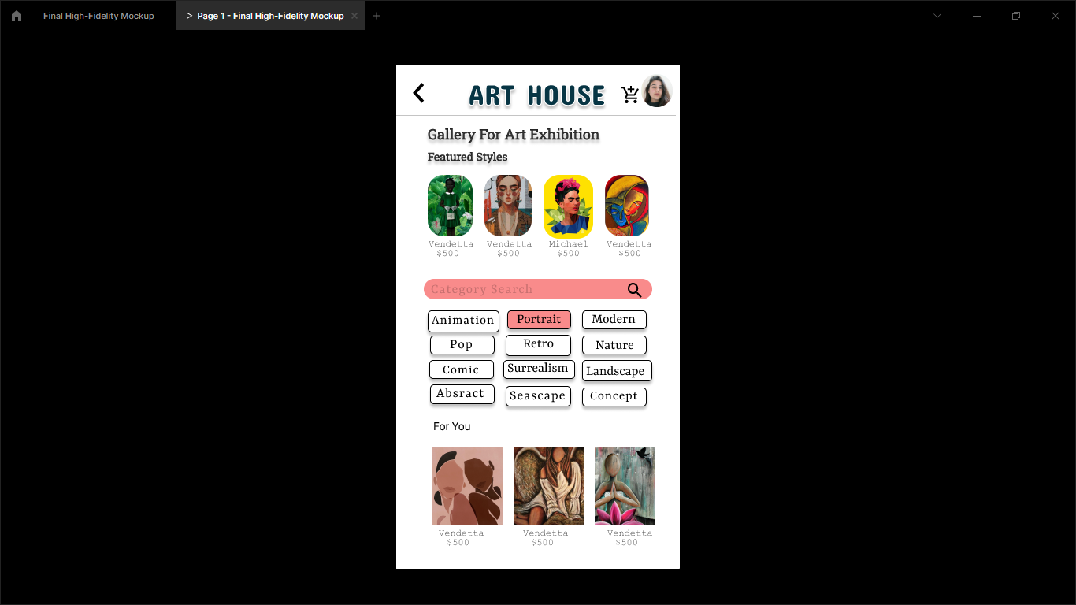
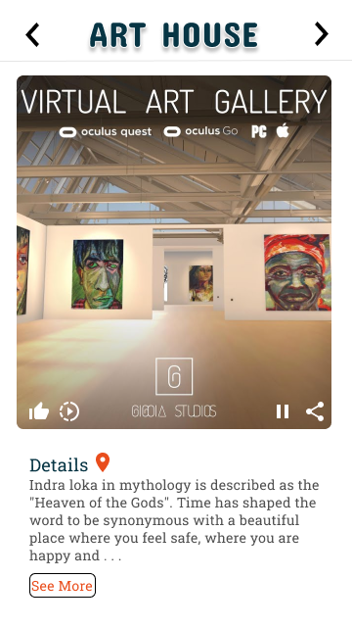
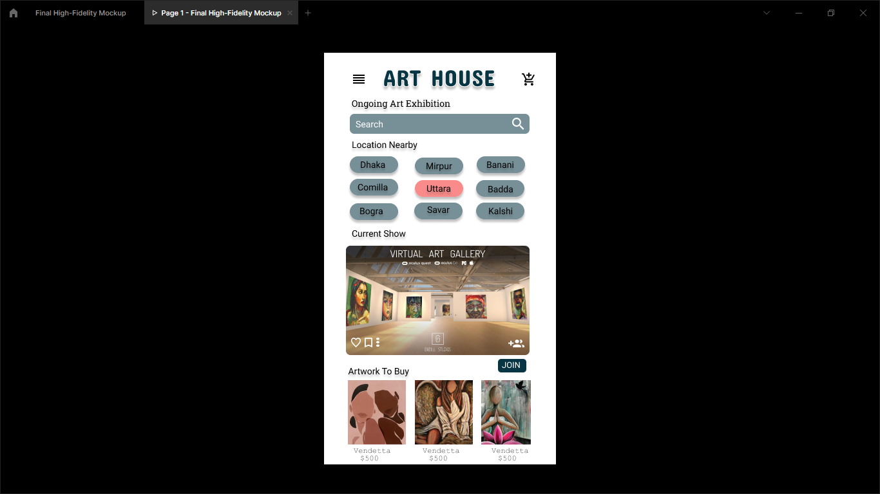
Project overview
Virtual Art Gallery
Here you can enjoy online
art exhibition at home.
Project duration:
6 Months

Slide 3
Project overview
The problem:
Existing app or website has no options for watching art exhibition live streaming from home and ordering artworks and connect with artists.
The goal:
The goal is to create a super usable app for all to watch exhibition at home and to connect with famous artists all over the world and buy artworks easily.

Slide 4
Project overview
My role:
Lead UX designer, UX researcher.
Responsibilities:
User research
Wireframing
Prototyping

Slide 5
User research
Personas
Problem statements
User journey maps
Understanding
the user

Slide 6
User research: summary
All findings are based on user interviews conducted within the four research areas in the respective selected councils. Supplementary research was also provided by additional participating councils to either validate or challenge findings

Slide 7
User research: pain points
1
2
3
4
Pain point
Pain point
Pain point
Pain point
No platforms for art lovers. Artists couldn’t connect easily.
Buying an artwork isn’t easy for art lovers and customers.
Because of traffic issues it was difficult enjoying art exhibitions. It is time consuming and waste lots of times.
Location and date of art exhibitions findings are not easy. Upcoming Exhibitions should be notified before.

Slide 8
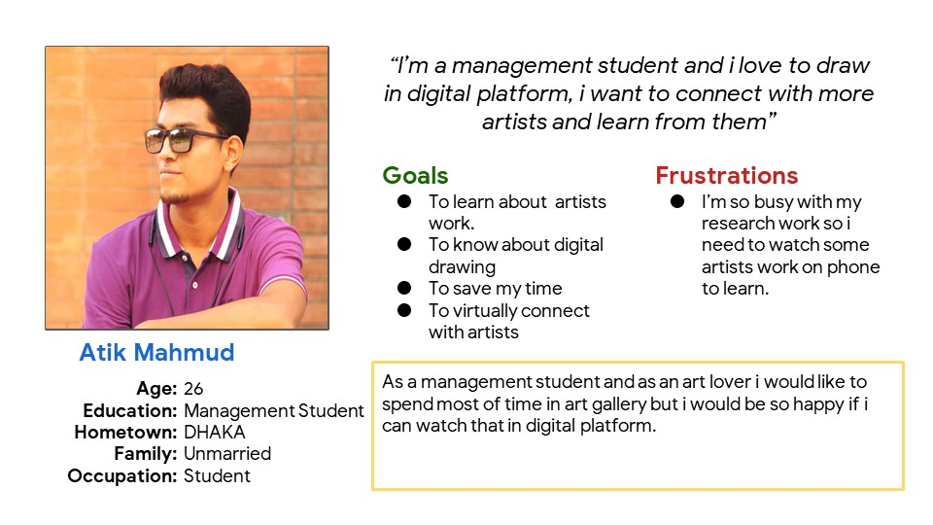
Persona: Atik Mahmud
Problem statement:
Atik is a management student who needs virtual art gallery app because he wants to connect with artists.

Slide 9
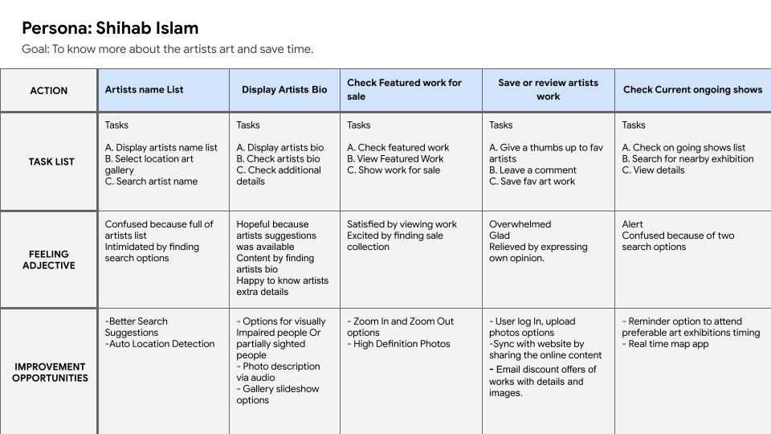
User journey map
Users every emotions during the page transition are noted and action task lists are given here.

Slide 10
Paper wireframes
Digital wireframes
Low-fidelity prototype
Usability studies
Starting
the design

Slide 11
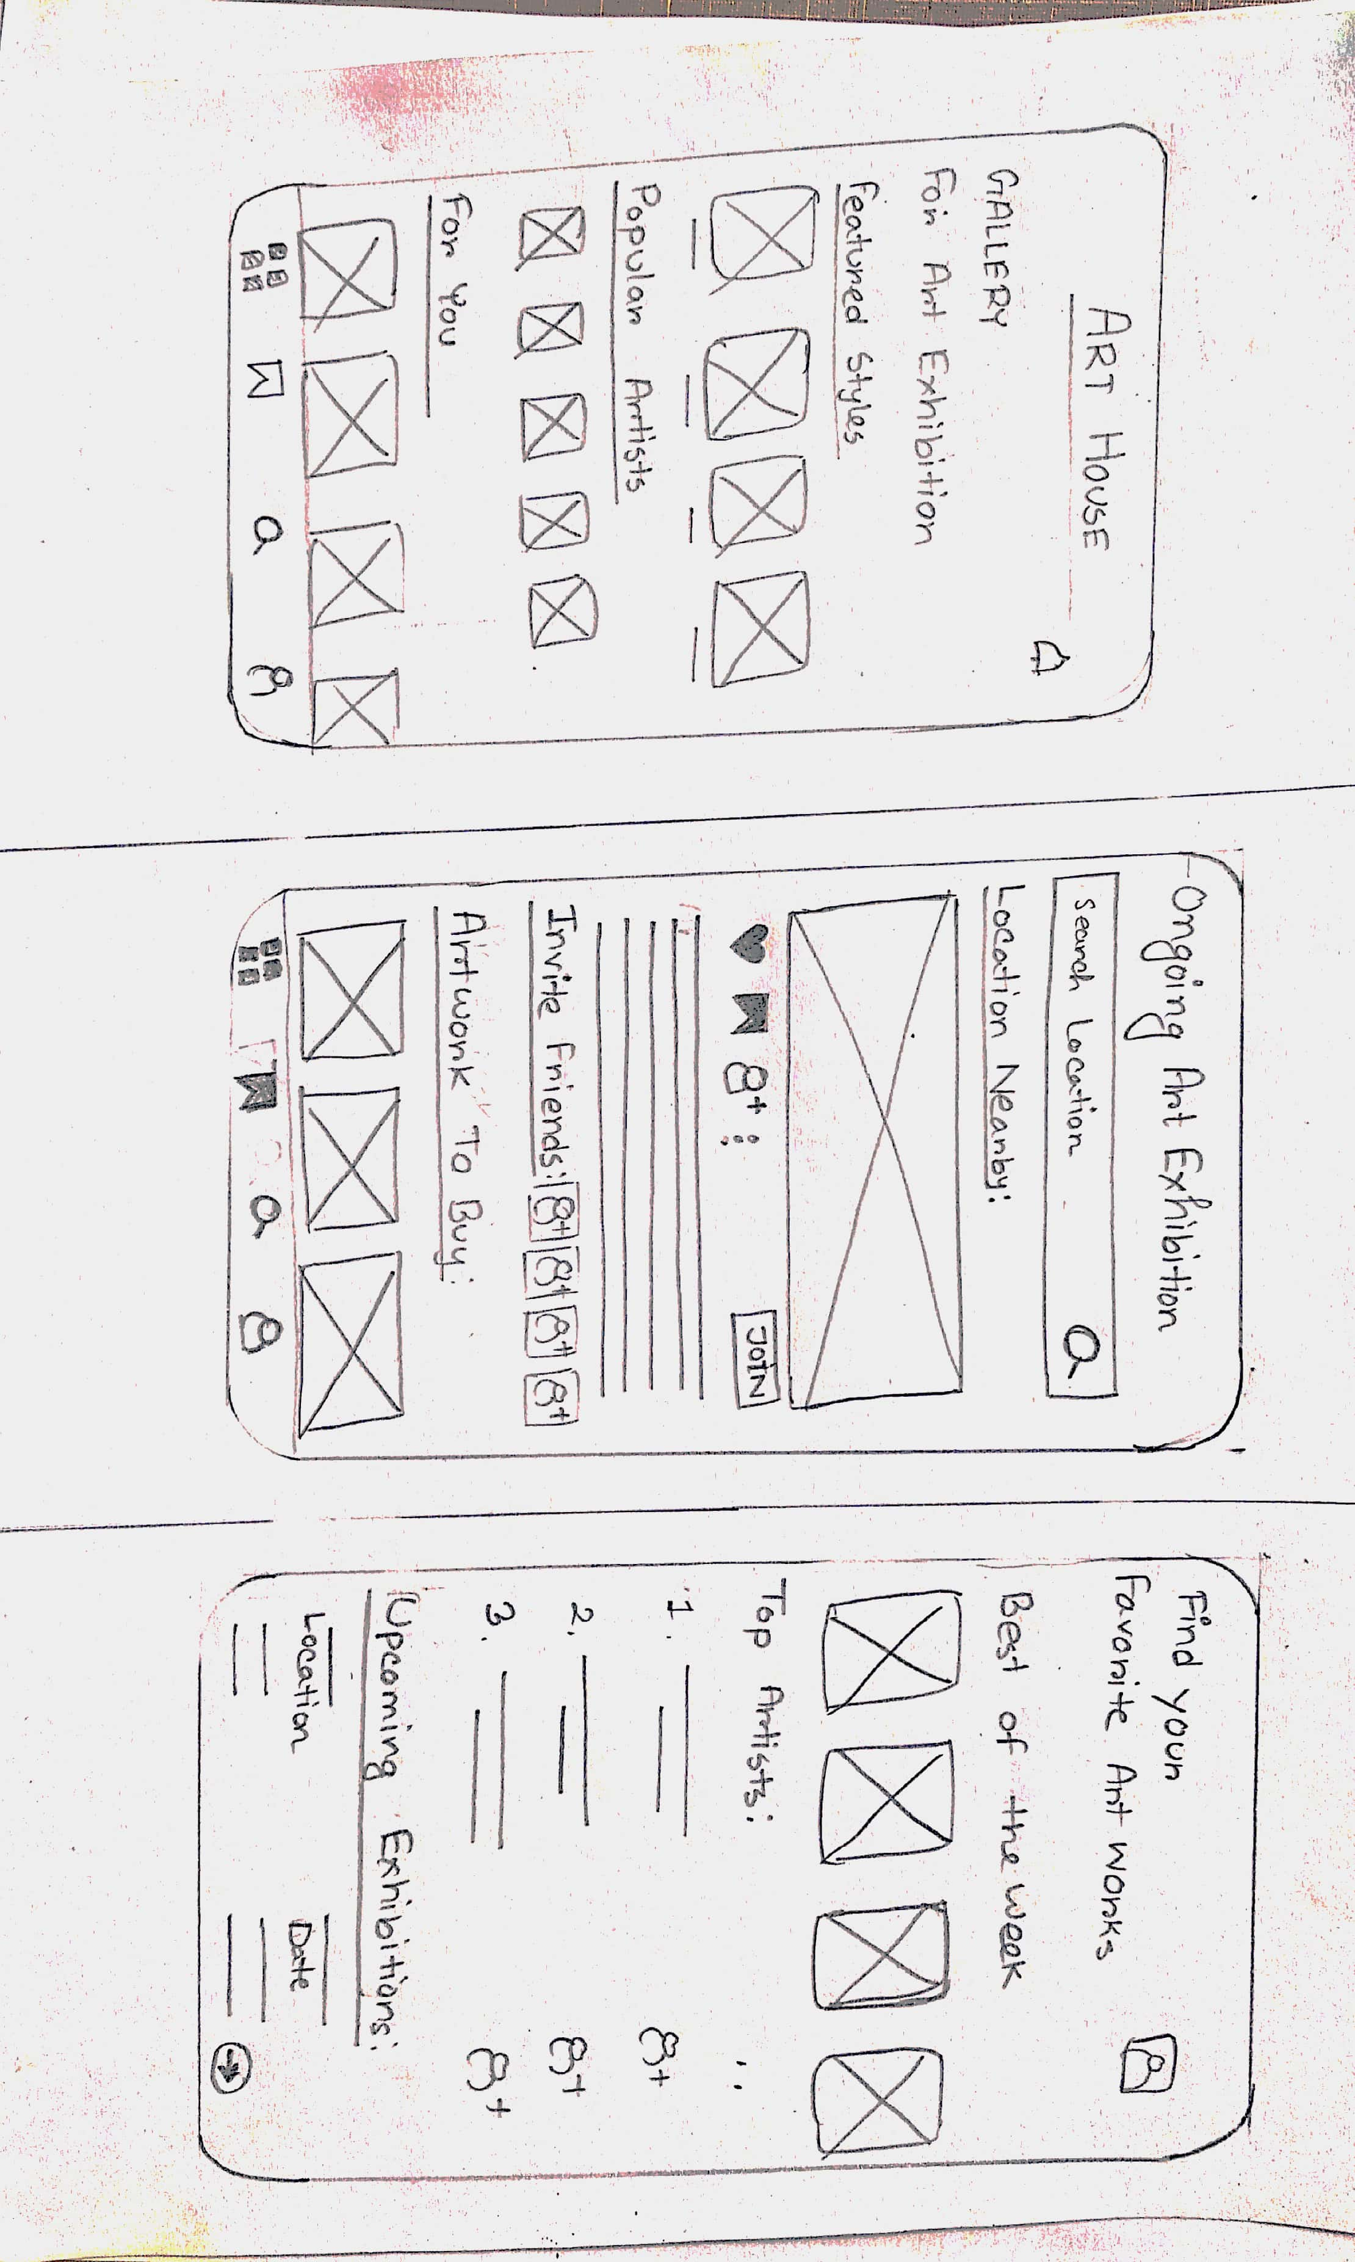
Paper wireframes
This is the basic Paper wireframes of my project.

Slide 12
A Brief Review Of Previous Presentation
Before Research:
User wants an online virtual exhibition art gallery.
“Art House” app has
Home Page ( Includes recent arts)
Location Search Page
Watch Exhibition Online
User Profile
Artists Profile
Other Features:
User can save, can upload artworks and images in gallery
User have album and buy list options
User can follow artists
User can select locations from current ongoing shows

Slide 13
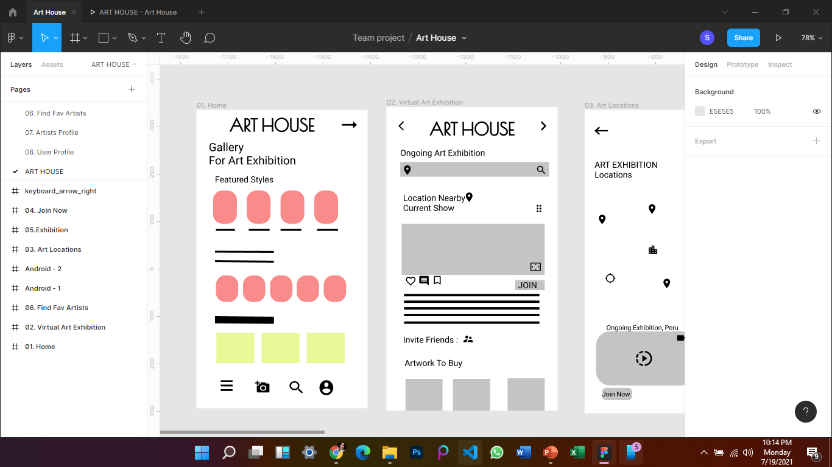
Digital wireframes
01.Home Page
This is the first page of the app as newsfeed.
Here all of the arts will be presented

Slide 14
Digital wireframes
User can search for location or join exisiting suggested exhibition
02. Virtual Art Exhibition
User will select this option to join Exhibition

Slide 15
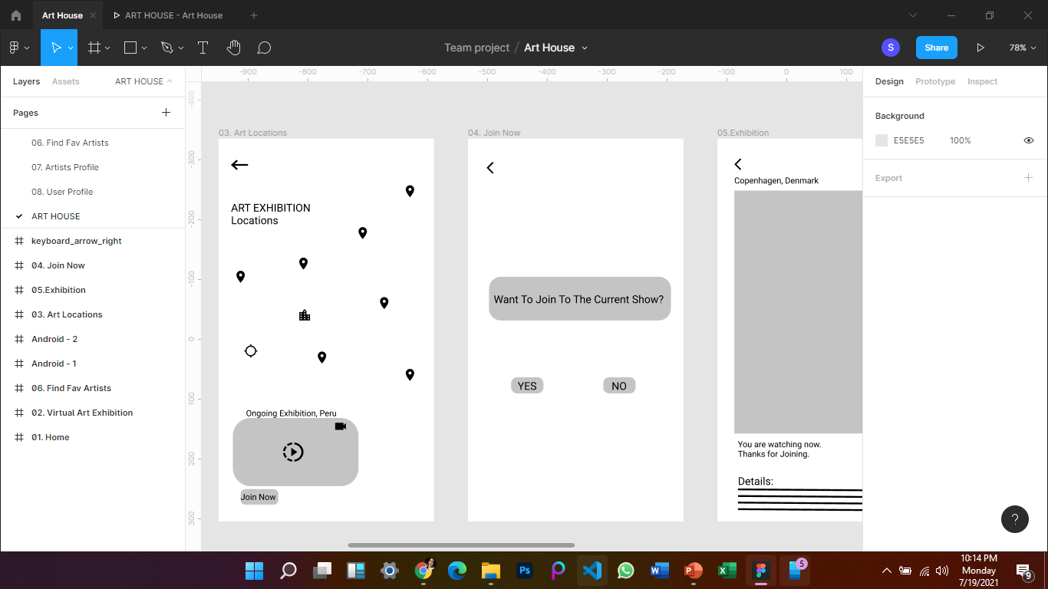
Digital wireframes
After Searching for locations, Map will be shown
03. Art Locations
User can choose preferred locations

Slide 16
Digital wireframes
Select Back option to go back to previous page
04. Join Now
Confim “yes” to join current show

Slide 17
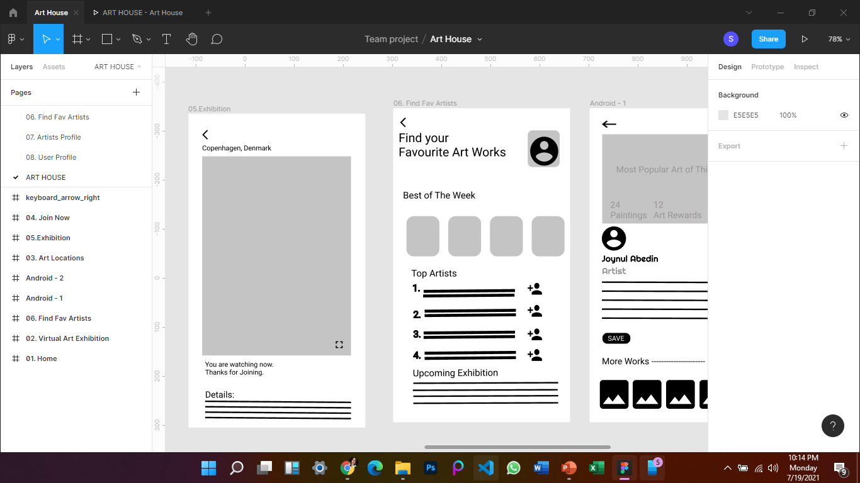
Digital wireframes
This is the exhibition page
05. Exhibition
Here user can read exhibition details

Slide 18
Digital wireframes
06. Find Your Fav Artists
Latest artwork is shown
Find top Artists and user can follow them.

Slide 19
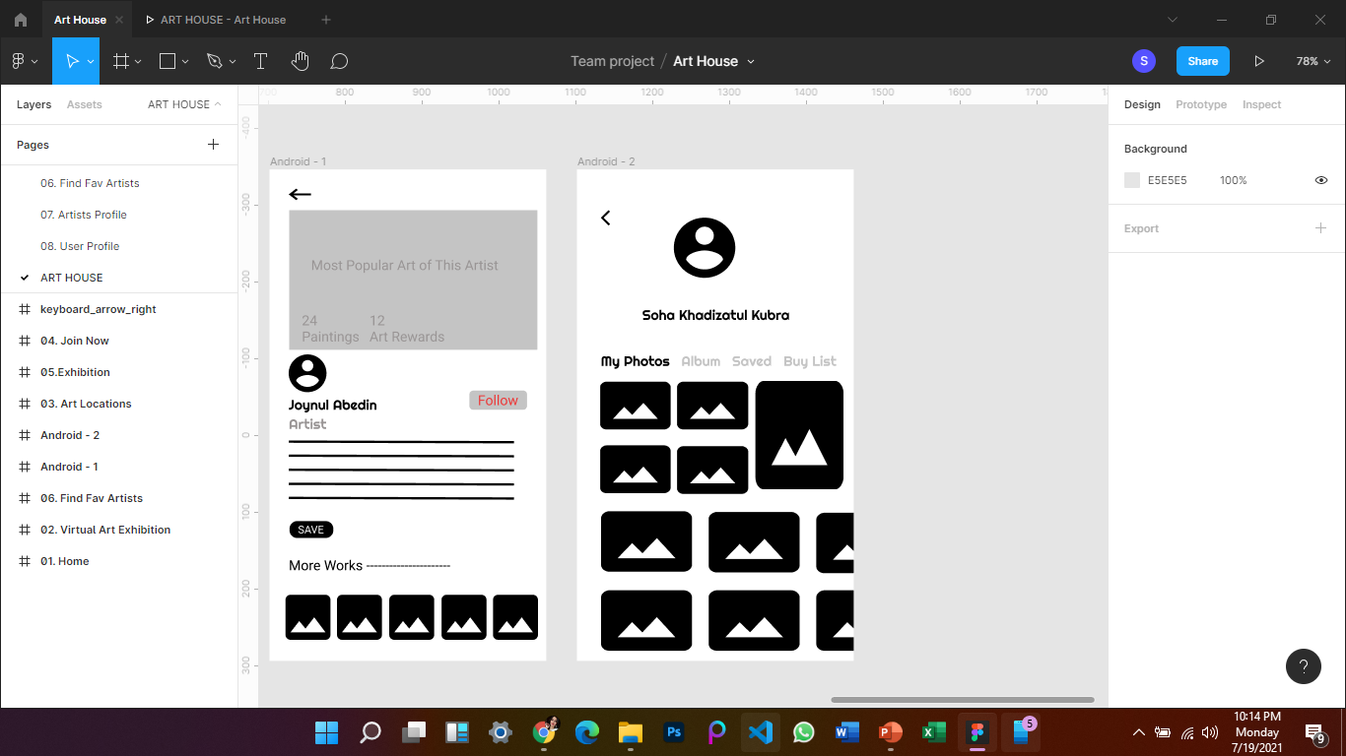
Digital wireframes
07. Artist Profile
Most popular art of the artists
Follow your fav artists
User can save fav artwork to their profile

Slide 20
Digital wireframes
User Profile and their saved photos.
08. User Profile
User Buy List Photos

Slide 21
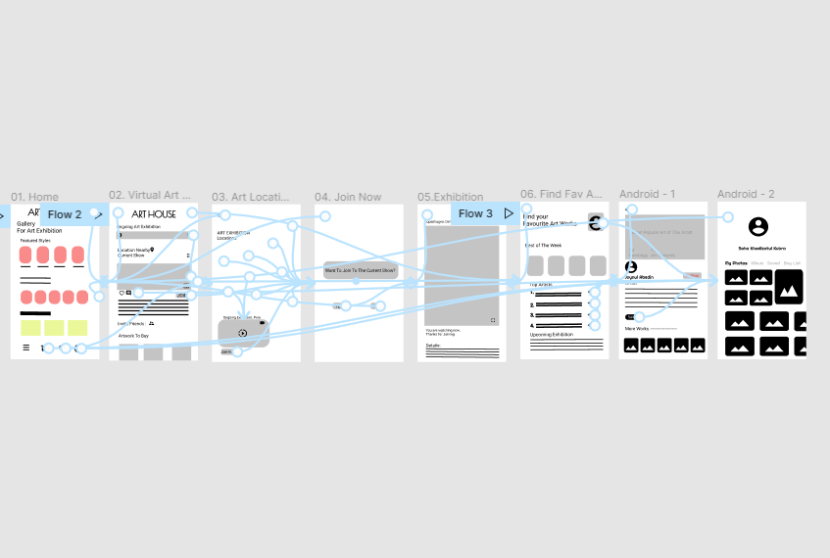
Low-fidelity prototype
Link: https://www.figma.com/proto/7TL4ohUCvCqdQFOTIqZg62/Art-House?page-id=19%3A140&node-id=19%3A141&viewport=501%2C343%2C0.24347825348377228&scaling=min-zoom&starting-point-node-id=19%3A141&show-proto-sidebar=1

Slide 22
Updated Presentation – 12.08.2021
Usability study: Findings
A short introduction to the usability studies I conducted and myfindings.
Round 1 findings
Round 2 findings
1
User wants suggested location
1
User wants review options before buying artwork
2
User prefers easier “Buy Now” option
2
User wants to share artworks on any social sites
3
User wants a category search option in gallery artwork
3
Upcoming exhibition reminders on Google Calendar

Slide 23
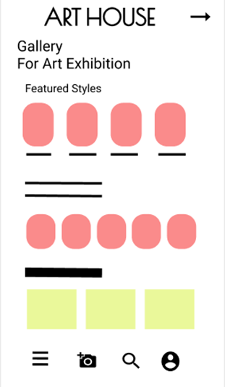
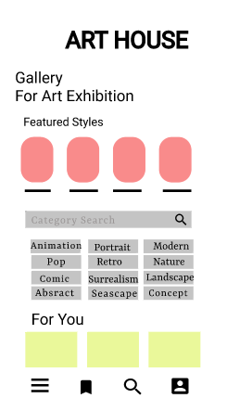
Before and After
Before usability study
After usability study
[ First page is bit confusing for most of the users. So, Category seach option is added in newsfeed]

Slide 24
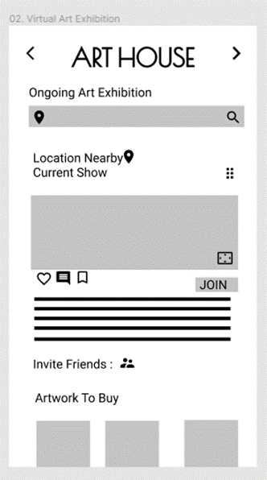
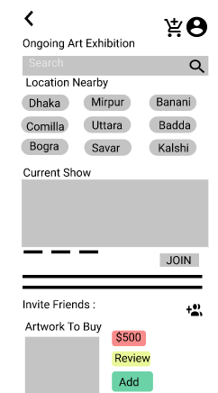
Before and After
Before usability study
After usability study
[ User wants suggested nearby locations]
Image of selected screen before usability study
Image of selected screen after usability study

Slide 25
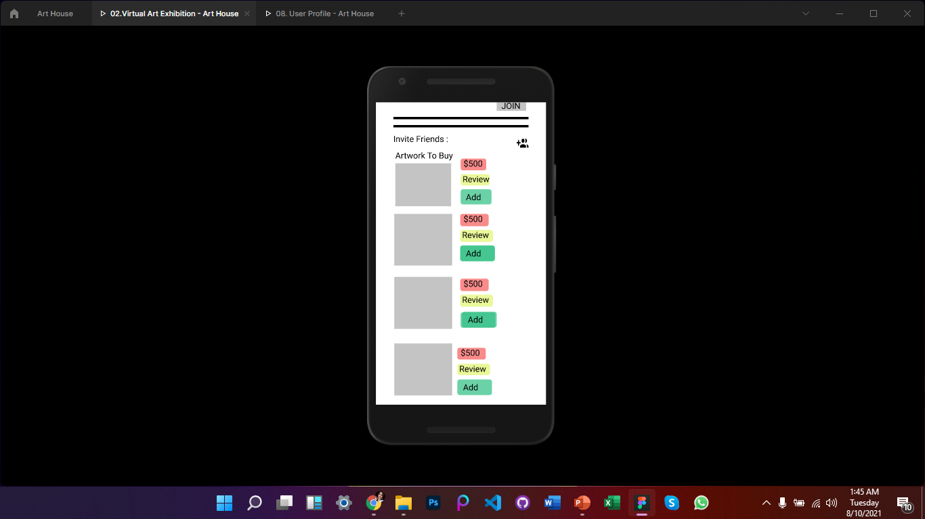
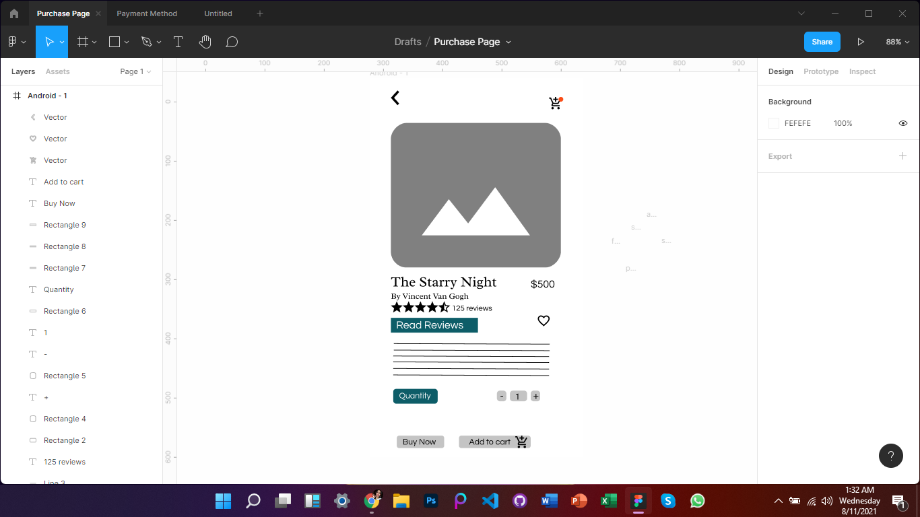
Before and After
Add to Cart Option Added
Shopping Cart
[Add to cart, Review and Easier payment options added]
Image of selected screen after usability study

Slide 26
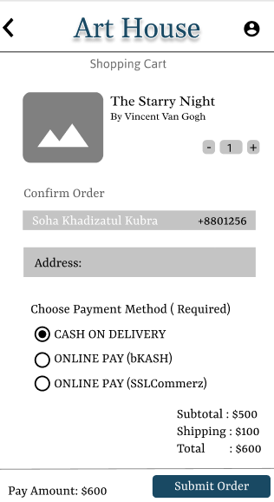
Before and After
Before usability study
After usability study
No Payment Method
[Easier payment method]
Image of selected screen after usability study

Slide 27
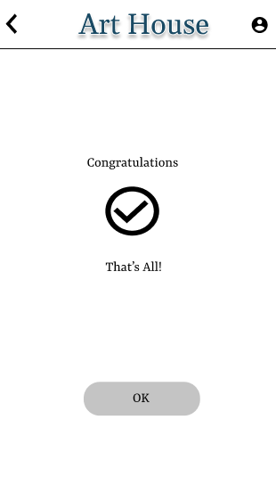
Before and After
Before usability study
After usability study
No Confirmation Message
[Confirmation Message]

Slide 28
Refining
the design
Mockups
High-fidelity prototype
Accessibility

Slide 29
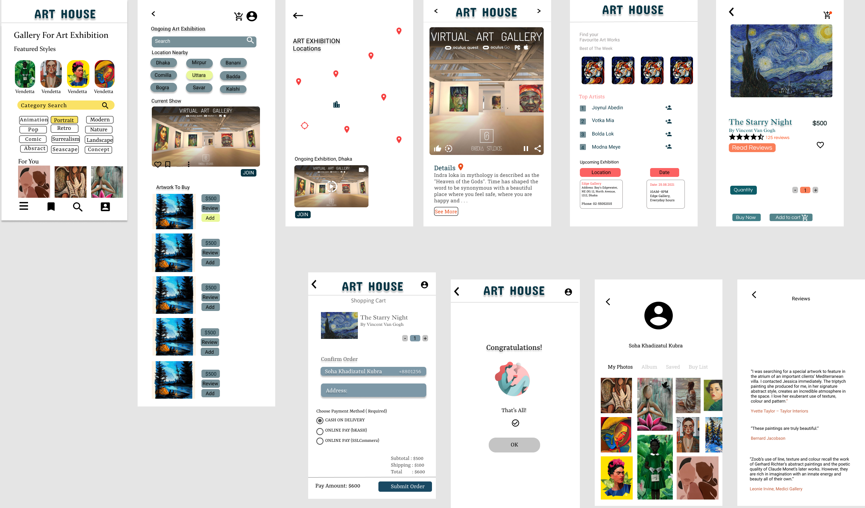
Refined Mockups

Slide 30
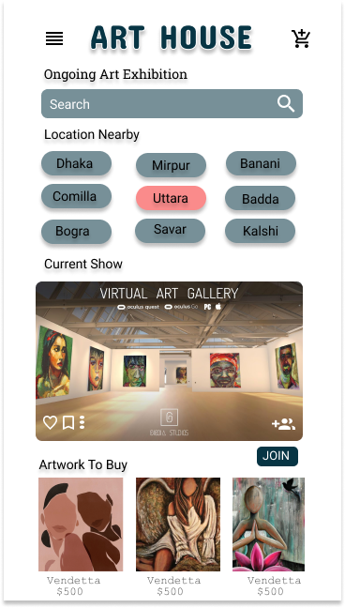
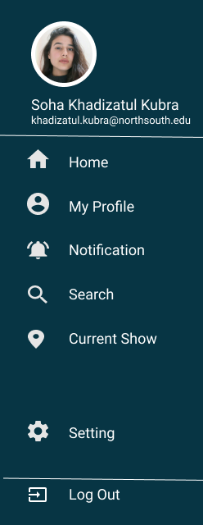
Mockups

Slide 31
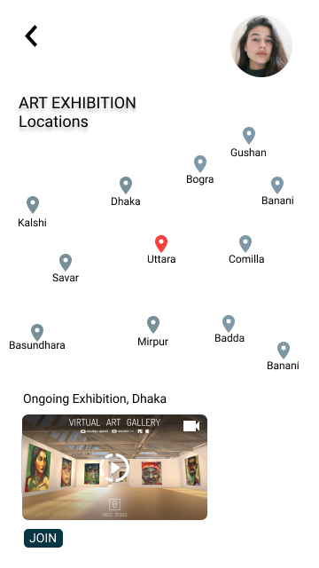
Mockups

Slide 32
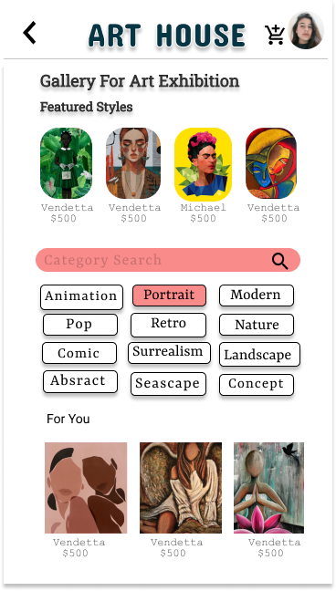
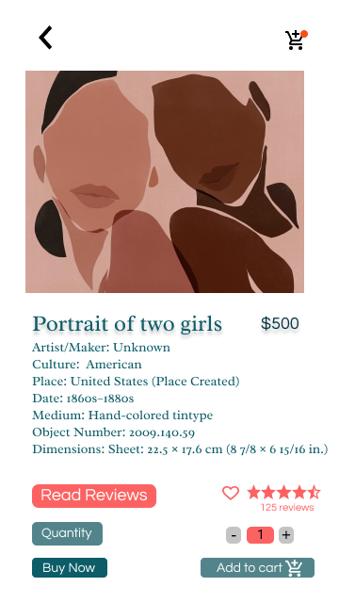
Mockups

Slide 33
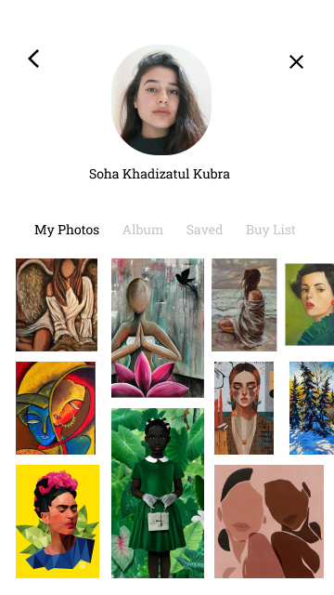
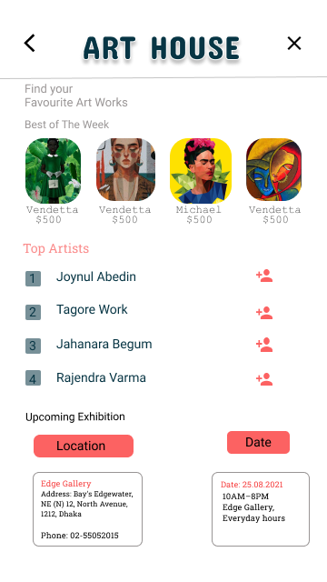
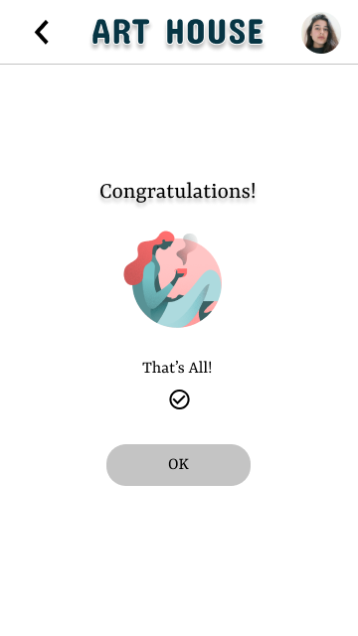
Mockups

Slide 34
Mockups

Slide 35
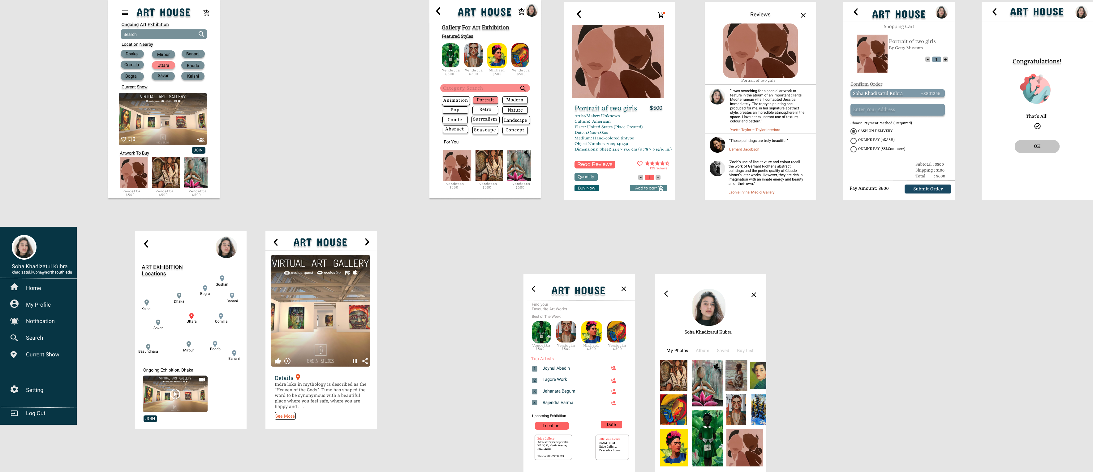
High Fidelity Prototype Mockup

Slide 36
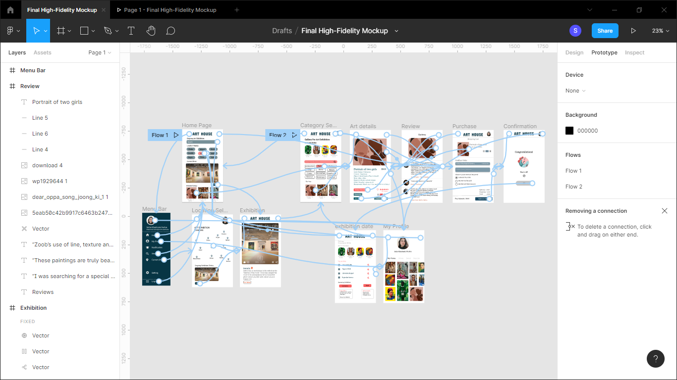
High-Fidelity Prototype
[https://www.figma.com/file/9JRx9CC5jIvRO0RSj81BtJ/Final-High-Fidelity-Mockup?node-id=0%3A1]

Slide 37
Accessibility considerations
1
2
3
Text legibility is preserved by an adequate contrast between the font color and the background.
WCAG 2.1 AA compliance, text have a color contrast ratio of at least 4.5:1
Used different contrast ratios for larger text because wider character strokes are easier to read at a lower contrast than narrower character strokes.
Touch targets are designed to at least 9 mm high by 9 mm wide.
Inactive space is added
surrounding smaller touch targets.
Buttons are placed where they are easy to access.
Flexible use for all interactive elements are allowed.
Minimized the amount of information on each page.
Provide a reasonable default size for content and touch controls to minimize the need to zoom in and out for users with low vision
Positioned all the form fields below (rather than beside, their labels)

Slide 38
Going forward
Takeaways
Next steps

Slide 39
Takeaways
Impact:
Selina Akter said,
“ This is a great app.What I liked in this app is simple design. You can intuitively navigate through it and it’s quite user-friendly. Very good job”
What I learned:
I learned about user research, user personas, different user stories, User research journey map, KPI questions, Users empath, pain points, Wireframing, Low fidelity and high fidelity prototype.

Slide 40
Next steps
1
2
3
In future, we will make try to make the 3D and VR options available for Digital Art Exhibition.
In future, we will make this app super friendly and easily navigate app for all art users because of limited time.
Exhibitions Ticket Booking System will also be available in near future.

Slide 41
Insert a few sentences summarizing the next steps you would take with this project and why. Feel free to organize next steps in a bullet point list.
Let’s connect!
Email – khadizatul.kubra@northsouth.edu

Slide 42
Thank you!

